Slide 1
Conditions
Python Class #4
With an s
HEHology

Slide 2
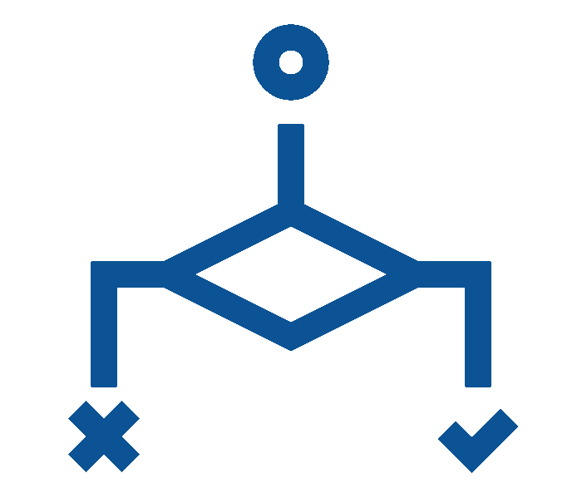
Conditions
What is that?
If case met then do something
For example(s):
If 3:00, end of school
If there are no eggs left, go to the supermarket to buy some
If hungry, eat
If done studying and chores, play
HEHology

Slide 3
Conditions
What’s the benefit?
To do something if true
Previous examples:
If 3:00, end of school
If there are no eggs left, go to the supermarket to buy some
If hungry, eat
If done studying and chores, play
HEHology

Slide 4
The Programming Part
HEHology

Slide 5
The Programming Part
Operators
<
<=
>
>=
==
!=
HEHology

Slide 6
The Programming Part
Statements
Classic if
if 9 < 1:
print('how is this true')
Else if
elif 9 == 1:
print('how is this true')
Else
else:
print('IT WORKS :D')
HEHology

Slide 7
The Programming Part
Combinations
And
if a > b and c > a:
print("Both conditions are True")
Or
if a > b or c > a:
print("Either condition is True")
Nested if
if x > 10:
print("Above ten,")
if x > 20:
print("and also above 20.")
else:
print("but not above 20.")
HEHology

Slide 8
The Programming Part
Operator combinations
if b < a < c:
print("b < a < c")
if b != a != c:
print("b,a and c aren’t equal")
HEHology

Slide 9
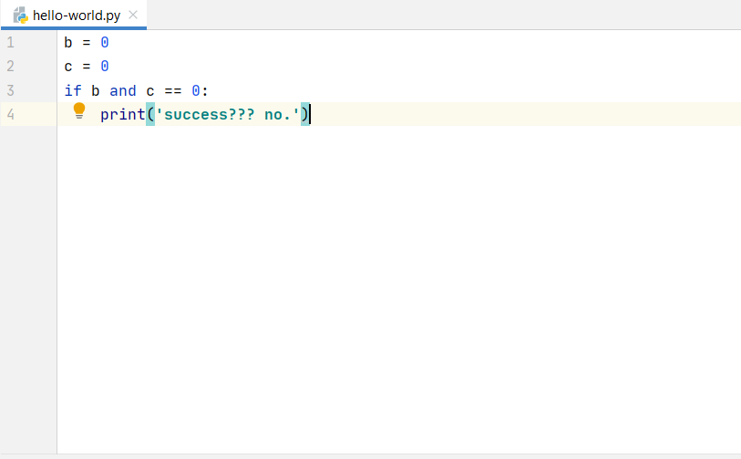
The thing with and and or
HEHology

Slide 10

Thanks!
Any questions?
HEHology

